Slide 1
Houston Housing
The Impact of Various Factors on Housing Costs

Slide 2
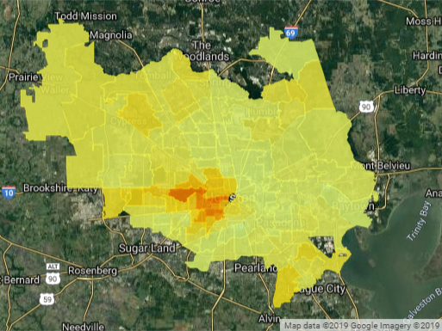
Property Value
Data Sources
FEMA
Zillow
Attom Data Solutions
Government Sources
Google Maps/APIs
Trends
Values rise in Downtown Houston
Smaller increases on the outskirts

Slide 3
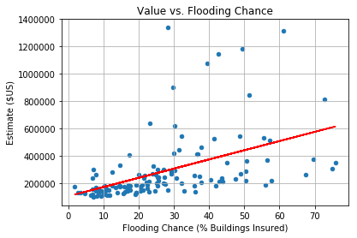
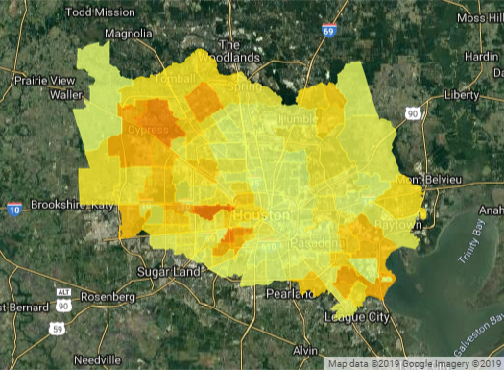
Flood trends
Data available for fewer zip codes
R-value is 0.467
Weak positive relationship

Slide 4
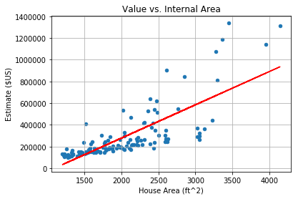
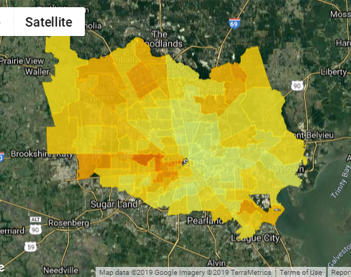
House Footage Trends
Fewer zip codes
R value is .772
Strong positive relationship

Slide 5
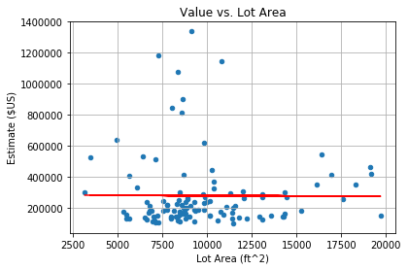
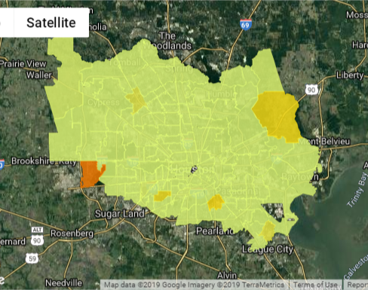
Lot Footage Trends
Fewer zip codes
R Value is -.006
No effective relationship

Slide 6
Crime trends

Slide 7
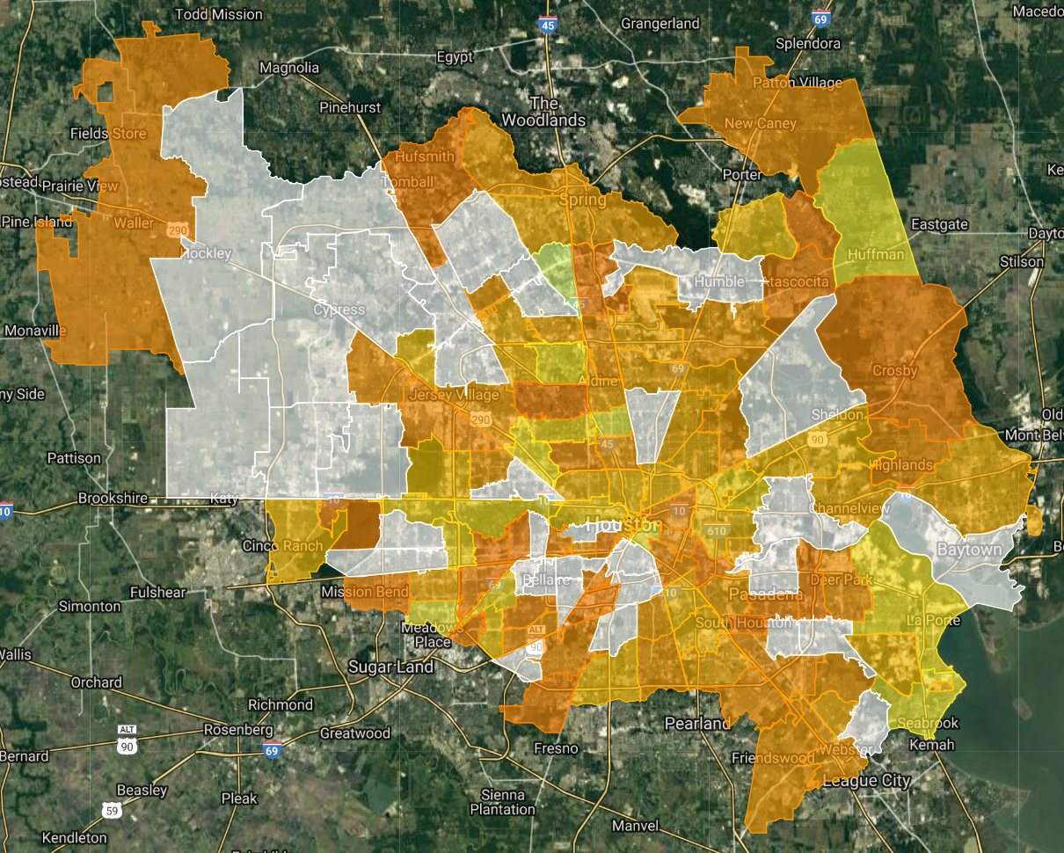
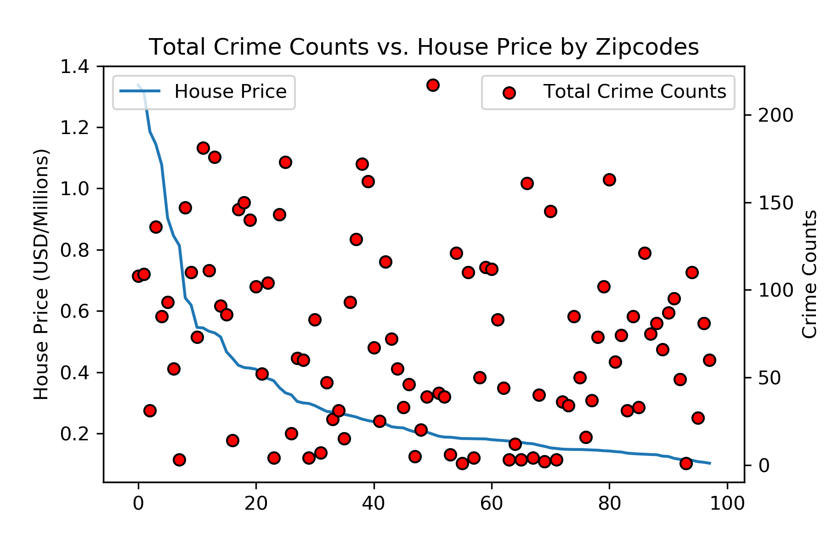
Crime Distribution by Zipcode
No obvious correlation (R² = 0.20)

Slide 8
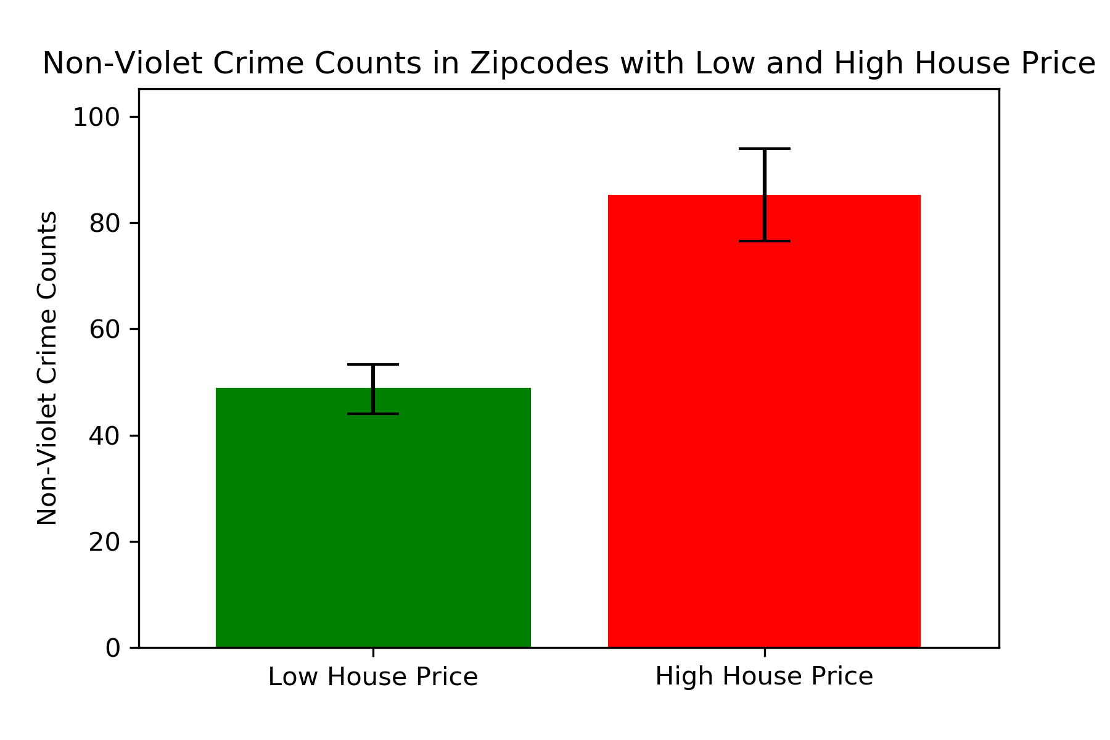
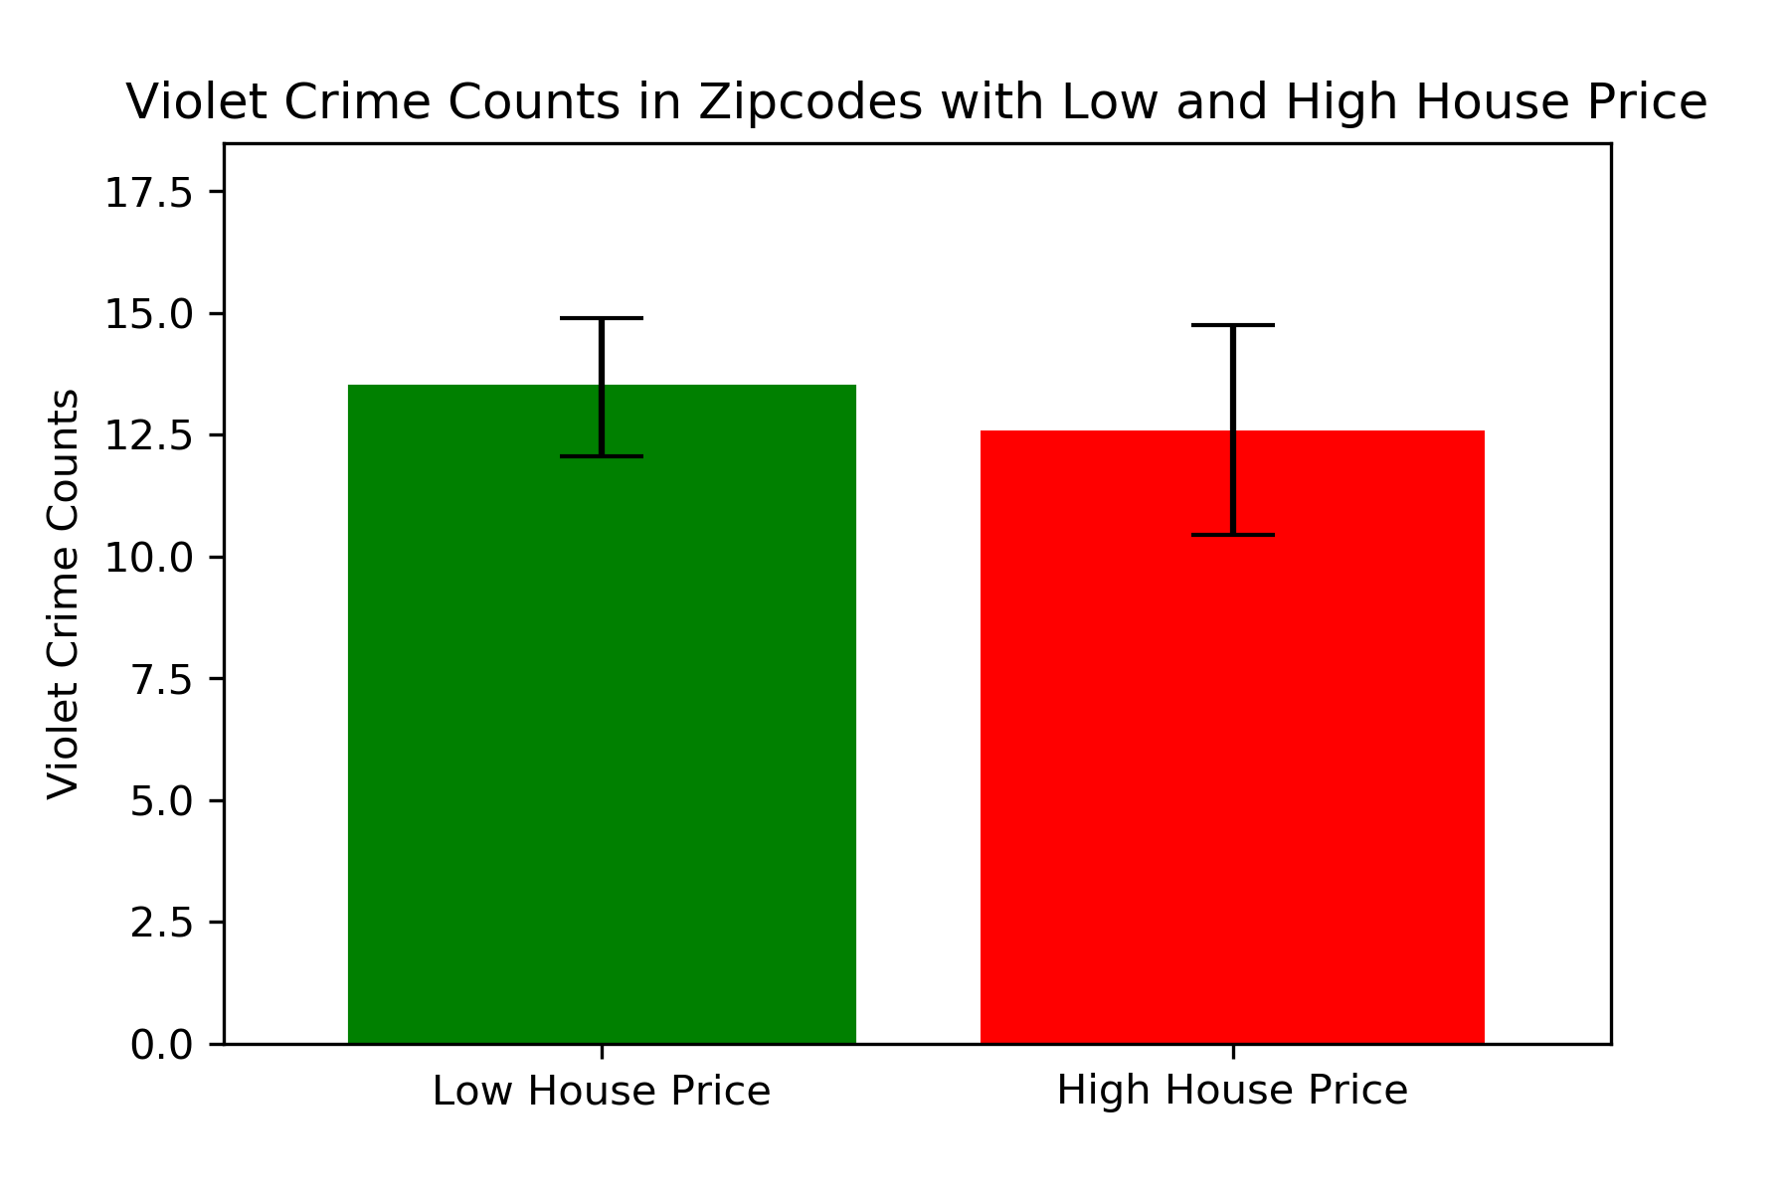
Crime Categories Impacted by House Price

Slide 9
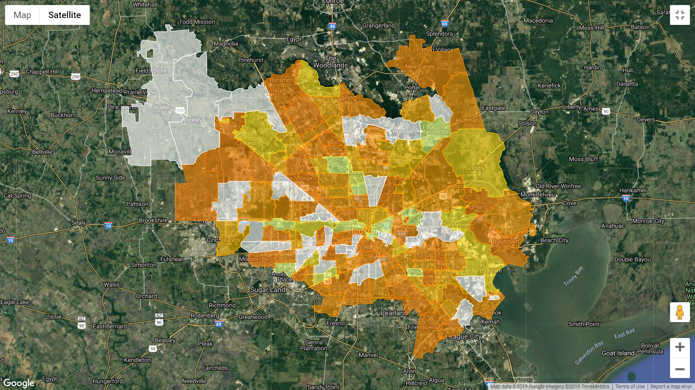
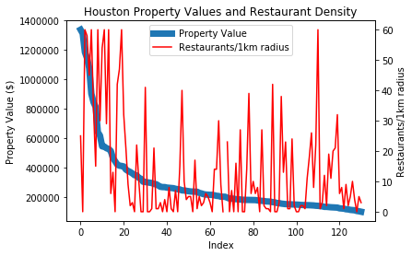
Restaurant Density
Correlation Coefficient: 0.47
weak positive linear relationship between property value and restaurant density
Highest restaurant density in central Houston and in some periphery

Slide 10
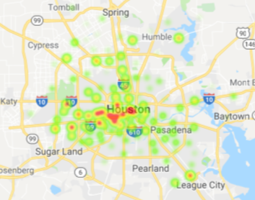
Restaurant Density
Correlation Coefficient: 0.47
weak positive linear relationship between property value and restaurant density
Highest restaurant density in central Houston and in some periphery

Slide 11
Final Insights

